Slide 1
Learning Objective
I will be able to apply differentiation to kinematics
Success Criteria
At the end of the lesson, I will be able to:
Apply differentiation to kinematics

Slide 2
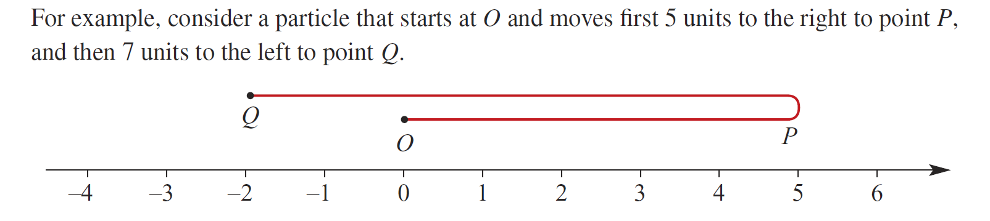
Distance vs Displacement
Concept Development
Distance
Displacement
Total of the absolute values of displacements
Only positive values
No direction
Scalar quantities
Can take on positive or negative values depending on direction
Vector quantities
What is the distance that the particle travelled?
12 units
What is the displacement that the particle travel?
-2 units

Slide 3
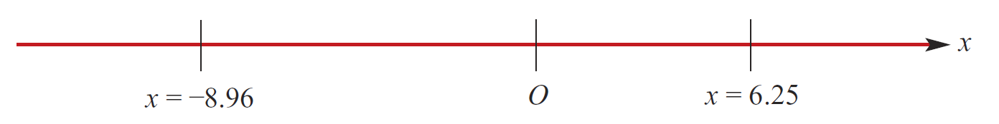
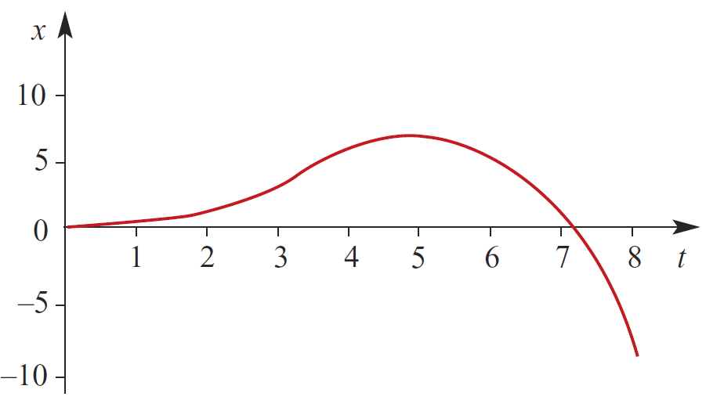



Concept Development
One of the key applications of differentiation is used in the study of motion.
Consider motion on a straight line with the origin O
$x$ metres is the distance relative to the origin O at time t
At time $t=0, x=0$
At time $t=5, x=6.25$
At time $t=8, x=−8.96$
If we were to plot the time and displacement graph:
For $0<t<7.1$, the position is positive, particle is right of O
For $t>7.1$, the position is negative, particle is left of O

Slide 4
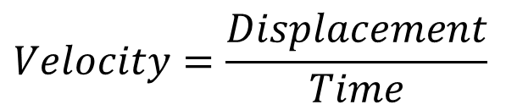
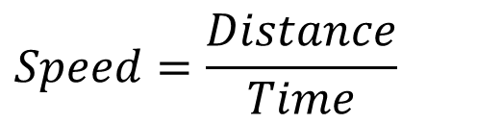
Vocabulary
Rectilinear motion: Motion in a straight line
Speed:
Change in distance over the change in time
Velocity:
Change in displacement over the change in time
Can take on positive or negative values depending on direction
Vector quantities
Only positive values
No direction
Scalar quantities
$$Speed=\frac{Distance}{Time}$$
$$Velocity=\frac{Displacement}{Time}$$

Slide 5

Rectilinear Motion Using Calculus
Concept Development
If $x(t)$ is a function describing the displacement of a body with respect to time.
Then the velocity, $v(t)$, of the body with respect to time is given by the first derivative of displacement.
$$\frac{dx}{dt}=x^{′}\left(t\right)=v(t)$$

Slide 6
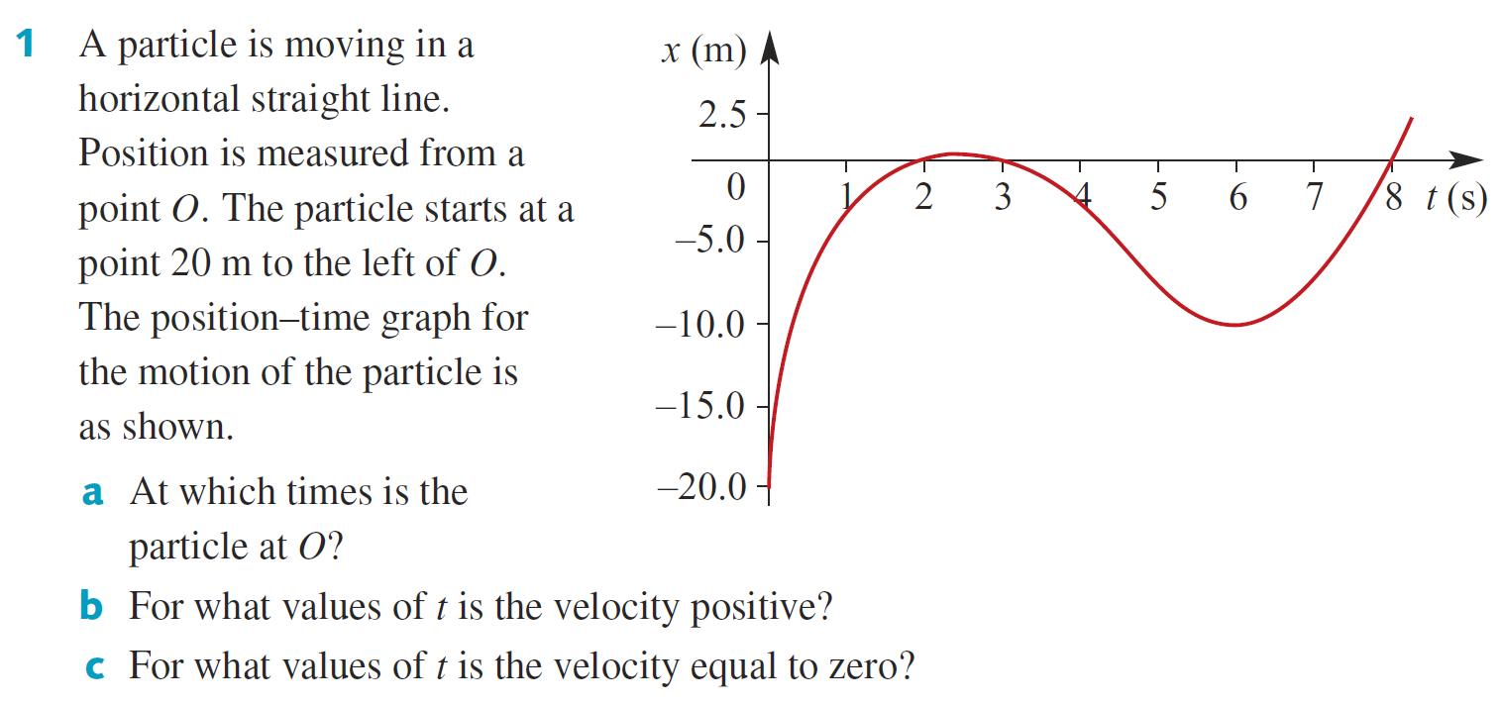

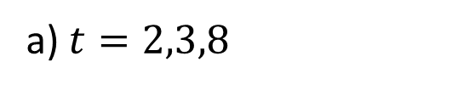
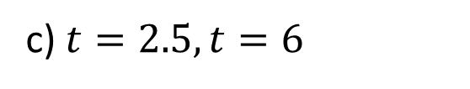
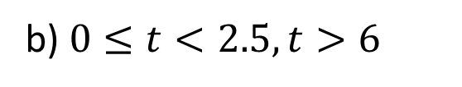
Guided Practice
a) $t=2,3,8$
b) $0≤t<2.5, t>6$
c) $t=2.5, t=6$

Slide 7
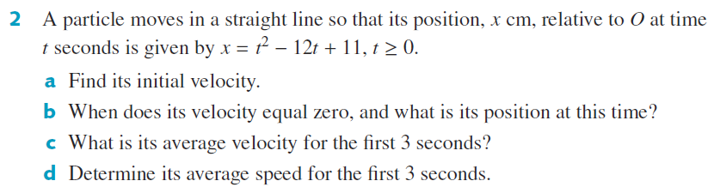
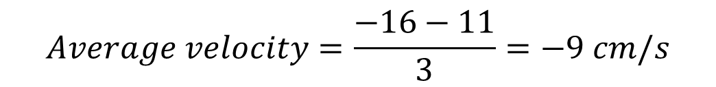

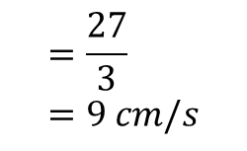
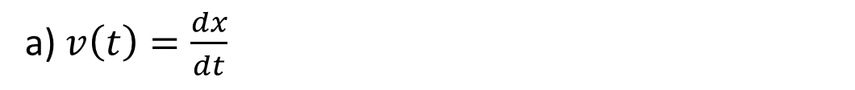
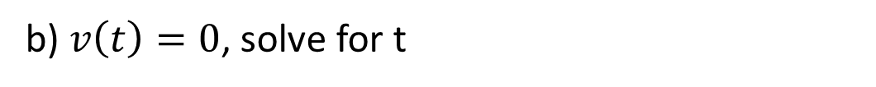
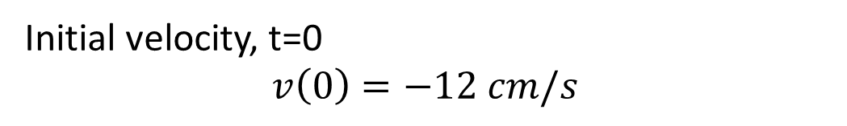
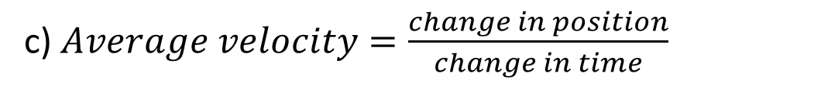
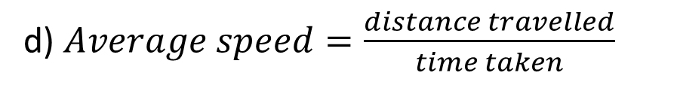

Guided Practice
a) $v\left(t\right)=\frac{dx}{dt}$
c) $Average velocity=\frac{change in position}{change in time}$
$v\left(t\right)=2t−12$
$$x\left(0\right)=11$$
$$x\left(3\right)=3^{2}−12\left(3\right)+11=−16$$
Initial velocity, t=0 $$v\left(0\right)=−12 cm/s$$
$$Average velocity=\frac{−16−11}{3}=−9 cm/s$$
b) $v\left(t\right)=0$, solve for t
d) $Average speed=\frac{distance travelled}{time taken}$
$$=\frac{27}{3}=9 cm/s$$
$$2t−12=0$$
$$t=6s$$
$$x\left(6\right)=6^{2}−12\left(6\right)+11=−25$$

Slide 8
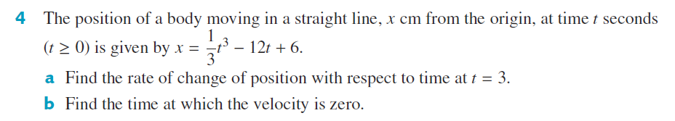




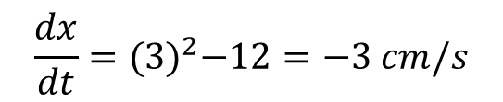

Guided Practice
a) Finding the instantaneous rate of change at $t=3$
$$\frac{dx}{dt}=t^{2}−12$$
$$\frac{dx}{dt}={(3)}^{2}−12=−3 cm/s$$
b) $\frac{dx}{dt}=t^{2}−12=0$
$$\left(t−\sqrt{12}\right)\left(t+\sqrt{12}\right)=0$$
$$t=\sqrt{12}$$
$$t=2\sqrt{3}s$$

Slide 9
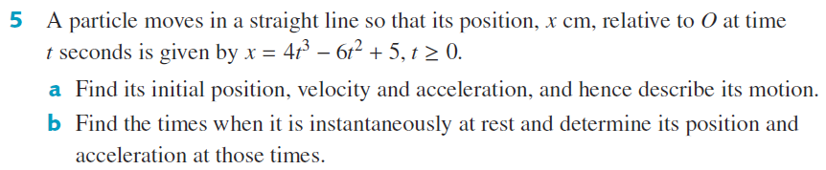



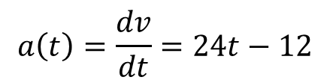


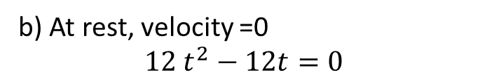

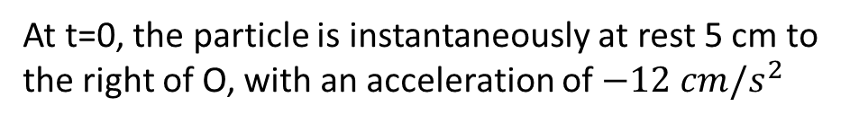

Guided Practice
b) At rest, velocity =0
$$12 t^{2}−12t=0$$
a)Initial position t=0, $x(0)=5$
$$v\left(t\right)=\frac{dx}{dt}=12 t^{2}−12t$$
$$12t( t−1)=0$$
$$v\left(0\right)=0 cm/s$$
$$t=0, t=1$$
To find acceleration, $a\left(t\right)=\frac{dv}{dt}$
$$x\left(1\right)=4{\left(1\right)}^{3}−6{\left(1\right)}^{2}+5=3$$
$$a\left(t\right)=\frac{dv}{dt}=24t−12$$
$$a\left(1\right)=12 cm/s^{2}$$
$$a\left(0\right)=−12 cm/s^{2}$$
At t=0, the particle is instantaneously at rest 5 cm to the right of O, with an acceleration of $−12 cm/s^{2}$

Slide 10
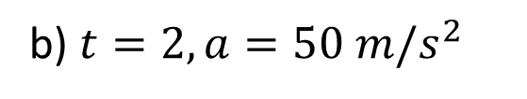
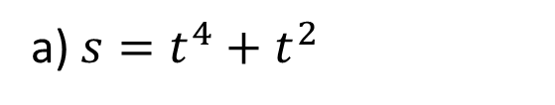

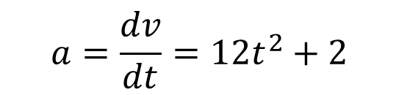
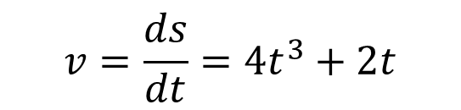
Guided Practice
a) $s=t^{4}+t^{2}$
$$v=\frac{ds}{dt}=4t^{3}+2t$$
$$a=\frac{dv}{dt}=12t^{2}+2$$
$$t=0, a=2 m/s^{2}$$
b) $t=2, a=50 m/s^{2}$

Slide 11
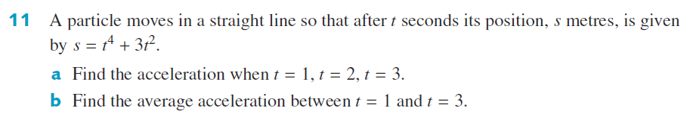
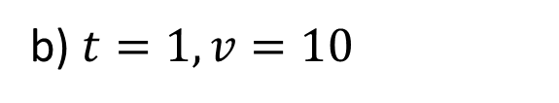
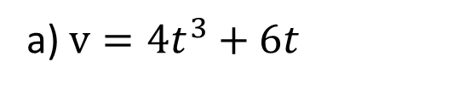


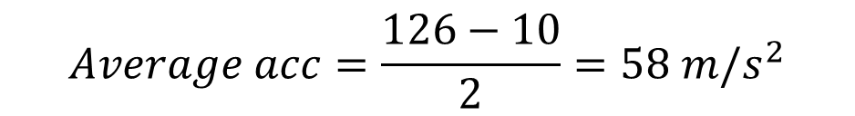

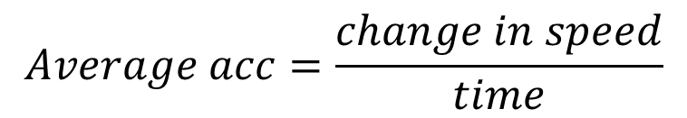


Guided Practice
a) $v=4t^{3}+6t$
$$a=12t^{2}+6$$
$$t=1, a=18 m/s^{2}$$
$$t=2, a=54 m/s^{2}$$
$$t=3, a=114 m/s^{2}$$
b) $t=1, v=10$
$$t=3, v=126$$
$$Average acc=\frac{change in speed}{time}$$
$$Average acc=\frac{126−10}{2}=58 m/s^{2}$$

Slide 12
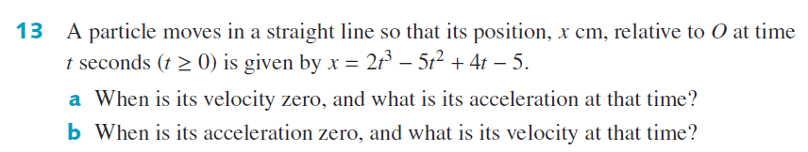

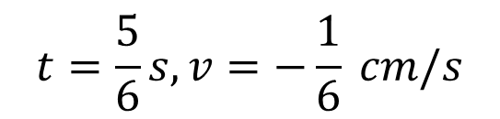
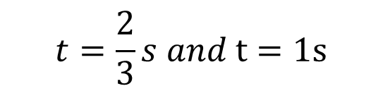

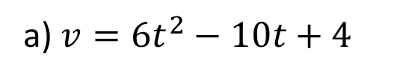

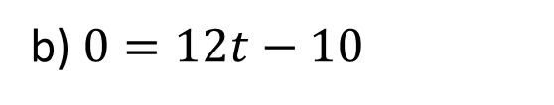


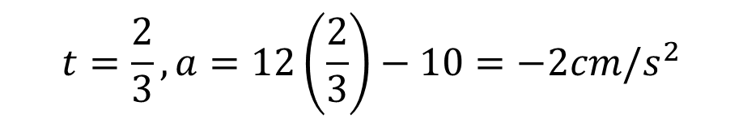
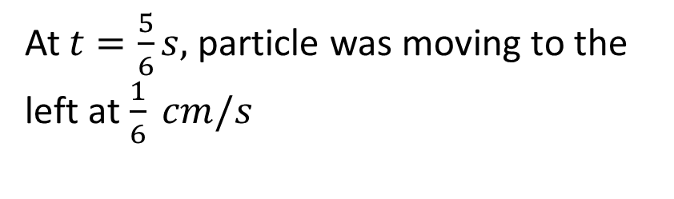
Guided Practice
a) $v=6t^{2}−10t+4$
b) $0=12t−10$
$$0=6t^{2}−10t+4$$
$$t=\frac{10}{12}=\frac{5}{6}s$$
$$3t^{2}−5t+2=0$$
$$\left(3t−2\right)\left(t−1\right)=0$$
$$t=\frac{5}{6}s, v=−\frac{1}{6} cm/s$$
$$t=\frac{2}{3}s and t=1s$$
At $t=\frac{5}{6}s,$particle was moving to the left at $\frac{1}{6} cm/s$
$$a=12t−10$$
$$t=\frac{2}{3},a=12\left(\frac{2}{3}\right)−10=−2cm/s^{2}$$
$$t=1,a=12\left(1\right)−10=2cm/s^{2}$$

Slide 13
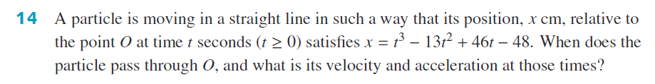



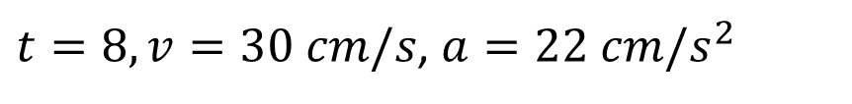

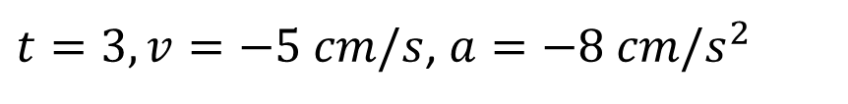

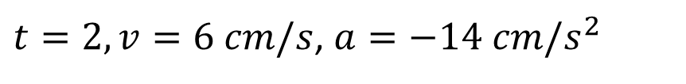
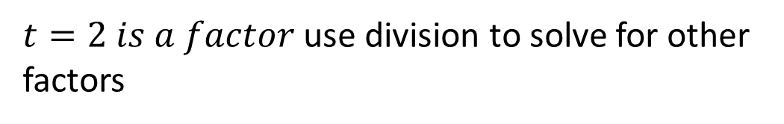

Guided Practice
When particle passes through O, displacement = 0
$$t^{3}−13t^{2}+46t−48=0$$
$t=2 is a factor$ use division to solve for other factors
$$\left(t−2\right)\left(t^{2}−11t+24\right)=0$$
$$\left(t−2\right)\left(t−3\right)(t−8)=0$$
$$t=2, t=3, t=8$$
$t=2, v=6 cm/s$, $a=−14 cm/s^{2}$
$t=3, v=−5 cm/s$, $a=−8 cm/s^{2}$
$$v=3t^{2}−26t+46$$
$t=8, v=30 cm/s$, $a=22 cm/s^{2}$
$$a=6t−26$$

Slide 14
Independent Practice
Complete Cambridge Ex 18F

